Slide 1


Slide 2
Existing Products
1. tv.com
2. radiotimes.com
3. cineplexbd.com
4. tvguide.com
5.Jagobd.com

Slide 3
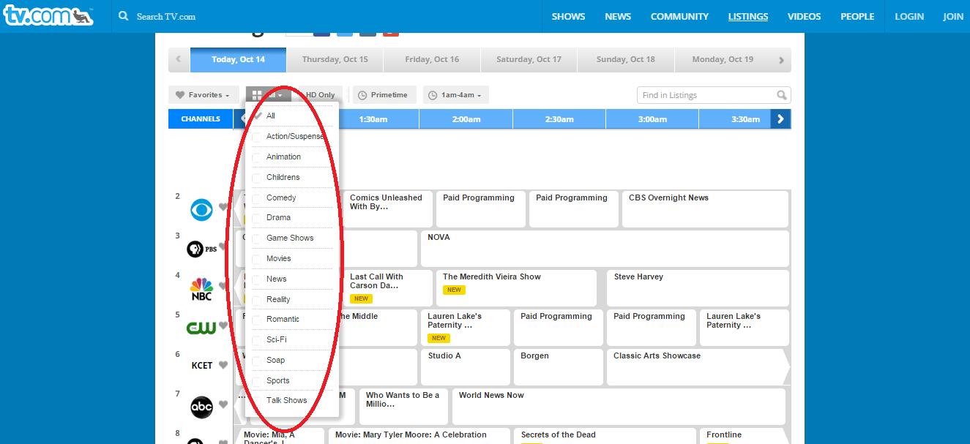
Image 1

Slide 4
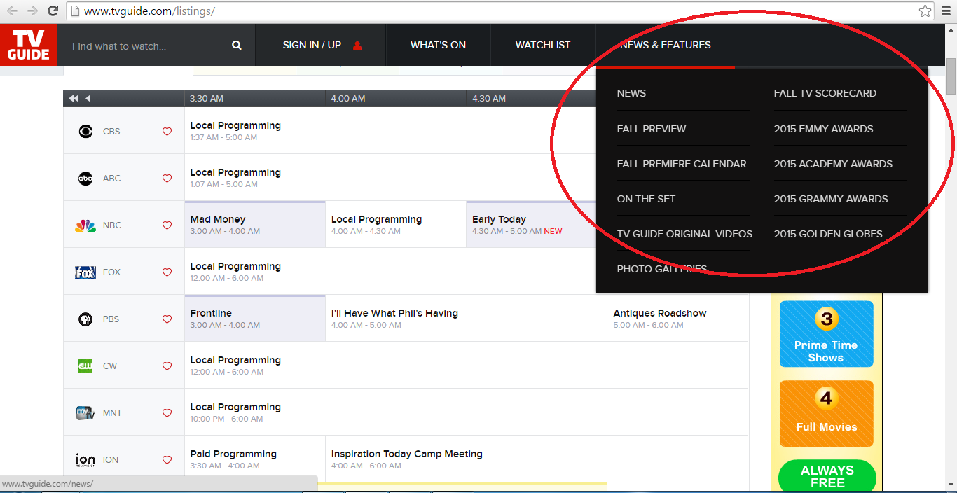

Slide 5
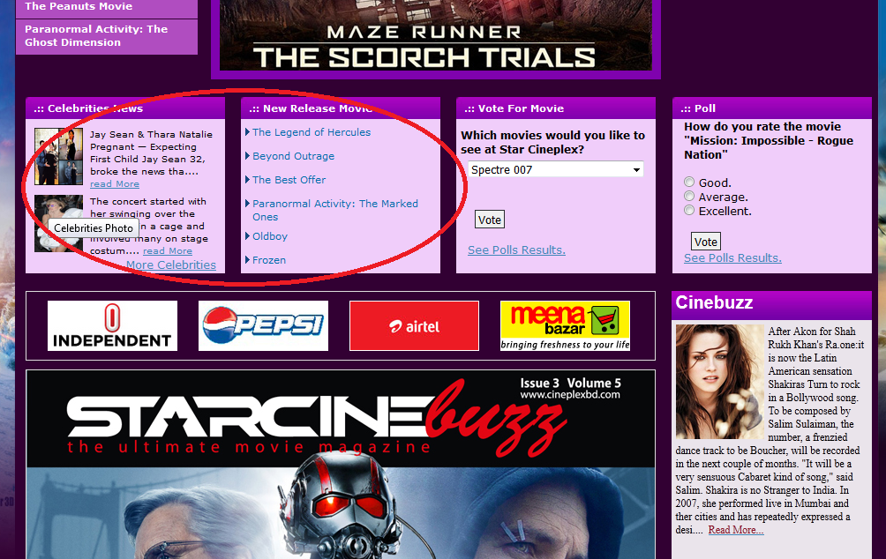

Slide 6
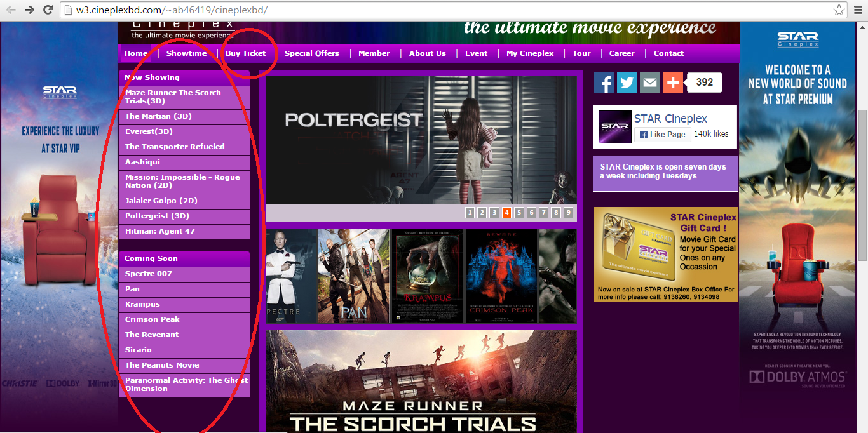

Slide 7
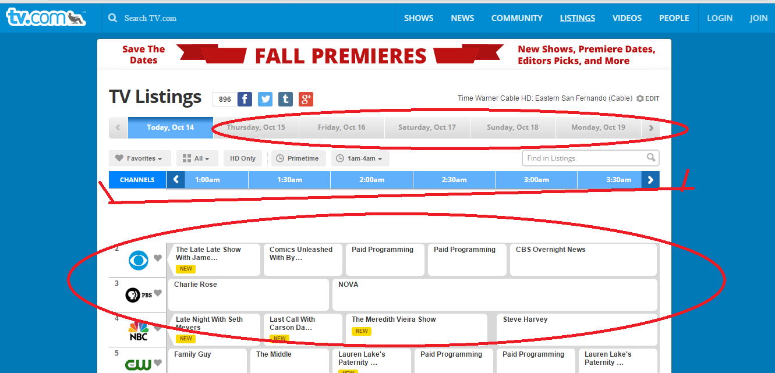

Slide 8
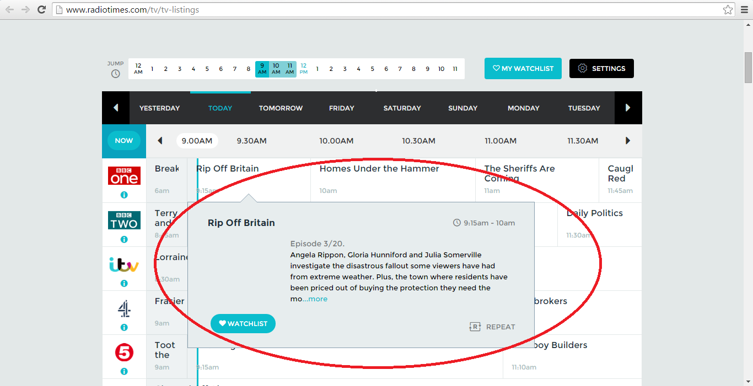

Slide 9
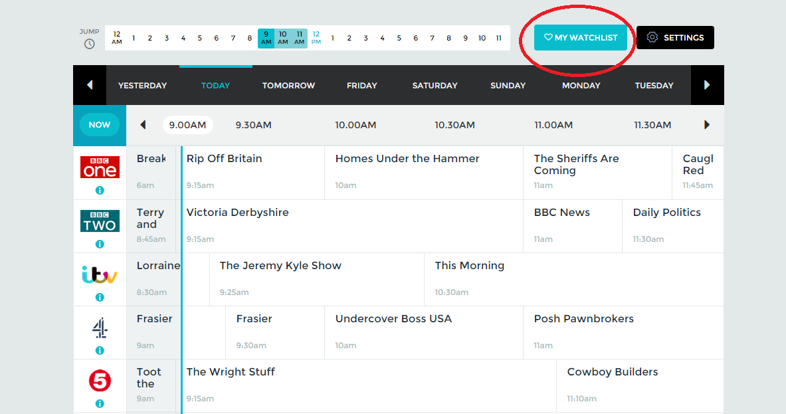

Slide 10
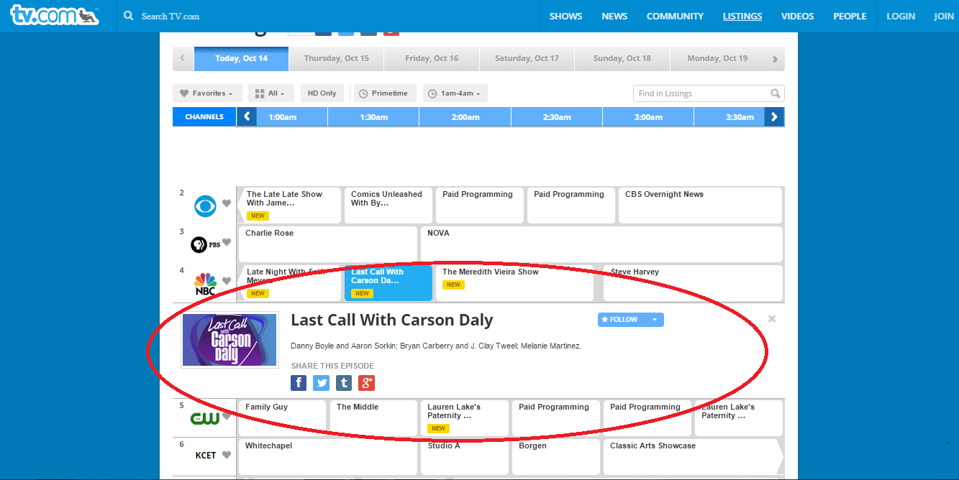

Slide 11
COMPARISON
Features | tv.com | radiotimes .com | cineplexbd.com | tvguide .com | Proposed Features
Program list up to 7 days | Yes | Yes | No | No | Yes
Types of program | Yes | No | No | No | Yes
Program description | No | Yes | No | No | Yes
News and features | No | No | No | Yes | Yes
Cinema | No | No | Yes | No | Yes
Hall ticket booking option | No | No | Yes | No | Yes
Popular programs | No | No | Yes | No | Yes
Search option | Yes | Yes | No | Yes | Yes
Sign up option | Yes | Yes | No | No | Yes
Contact | Yes | Yes | Yes | Yes | Yes
Live Tv | No | No | No | No | Yes

Slide 12
Features
TV Program list up to 7/15 days (all channel)
Types of program (search by category)
Program Watchlist with mobile phone alert of starting a program.
User’s event reminder/alert (ex. Birthdays, anniversary, assignment submission last date, exam dates)
Upcoming & running Cinema list
Hall ticket booking option
Popular programs and movie
Search option (categorized, channel, date, program)
Sign up option
Commenting on program
Live Tv

Slide 13
1. Menu: Home Submenu: Program list up to 30 days Program description News and features Cinema Gallery Popular programs Search option Signin and Sign up option Contact Comment Box

Slide 14
2. Menu: ALL Submenu: Drama Telefilm Talk Show Reality Show Comedy Health & Lifestyle Sports Travel Food & Cooking Educational Business Kids Religious Agricultural Programs Music Show Awards News

Slide 15
3. Menu: Cinema
Submenu:
Running Cinema Up Coming Cinema News
Hall Ticket Booking → [Submenu: Cineplex Blockbuster
Bolaka ]

Slide 16
4. Menu: Gallery
Submenu:
Photo Gallery
Video Gallery

Slide 17
5. Menu: News & Features
Submenu:
News
2015 Awards
2015 Academy Awards
2015 National Awards
2015 Meril Prothom Alo Awards

Slide 18
Other Menu :
6. Popular Program
7. Sign Up
8. About Us
9. Contact

Slide 19
Stake holder / Actors
Admin
TV correspondent
Cineplex operator
User
Register user
Non Register user

Slide 20
Task of Admin
1. Upload Programs
2. Update Programs
3. Remove Programs
4. Approve request
5. User enrollment

Slide 21
Task of Cinema Operator
1. Upload Cinema Provide by cineplex
2. Update
3. Remove
4. Approve request
5. User enrollment

Slide 22
Task of TV correspondent
1. Upload program and schedule
2. Update program and schedule
3. Remove program and schedule

Slide 23
Task of user
Register
Can visit all pages and also use My Watchlist services
Non register
Can visit all pages but can’t use My Watchlist services

Slide 24
Process Flow Diagram of Admin
Login
Login
Admin home page

Slide 25
Process Flow Diagram of Admin
Upload
Type
Upload programs
Select category
Upload
Create new category
Browse

Slide 26
Process Flow Diagram of Admin
Delete
Delete programs
Select a program from program list to delete
Delete

Slide 27
Process Flow Diagram of Admin
Update
Update programs
Select a program from program list to update
Update

Slide 28
Process Flow Diagram of Admin
User permission
Permission of TV correspondent
Select Permission
All
1.Visit all page
2.Insert TV program & schedule
3.delete
4.
update
All
1.Visit all page
2.Insert TV program & schedule
3.delete
4.
update
Maintain user / permission
Permission of Register user
Select Permission
Permission of Non-Register user
Select Permission
All
1.Visit all page
2.Insert TV program & schedule
3.delete
4.
update

Slide 29
Process Flow Diagram of Register User
Sign Up
Sign Up
Login
Register Homepage

Slide 30
Process Flow Diagram of Register User
Program List
Home
Program List of 15 days

Slide 31
Get program starting alert
Program list
Program
All
Catagories
Program
Add to watchlist
Time Selection Option
User will get notification before starting program Time will be selected by user

Slide 32
Live TV
Watch live
Program

Slide 33
About cinema
Running cinema
Cinema
Short description
Trailer
Upcoming cinema

Slide 34
Hall ticket booking procedure
Cinema
Running cinema list
Cinema description
Upcoming cinema list
Hall list
Cineplex Website Buy ticket system
Buy ticket

Slide 35
Comment on a program
Program List
Program
comment box

Slide 36
Categorized program list
All
Select catagory
Programing list

Slide 37
Popular Program
Popular Program
Most Favourite Program

Slide 38
See My Watchlist
Loging or sign up option
My watchlist
Showing registers users watchlist

Slide 39
Searching program
Showing found program
Search
Enter program name

Slide 40
Contact
Skype call
Contact
Call us
and
E-Mail

Slide 41
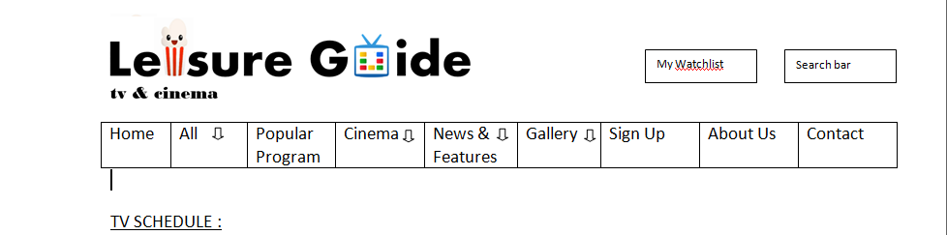

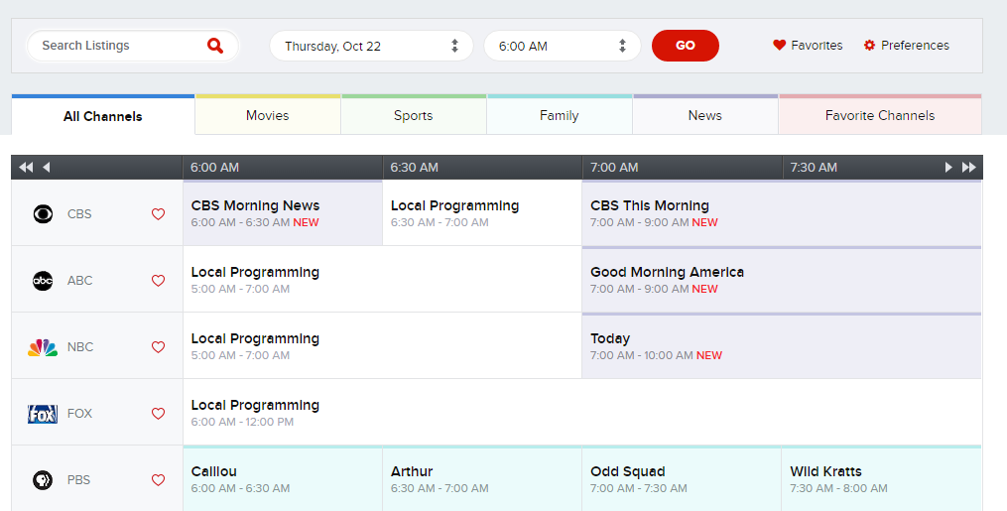





Watch Live
Watch Live
Watch Live
Watch Live
Watch Live

Slide 42
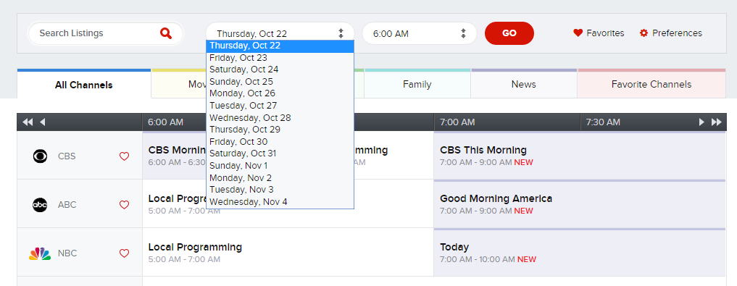
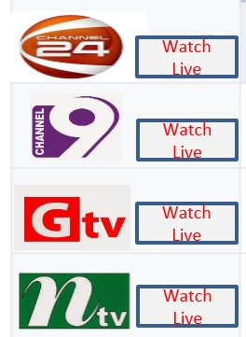

Slide 43
Watch Live

Slide 44
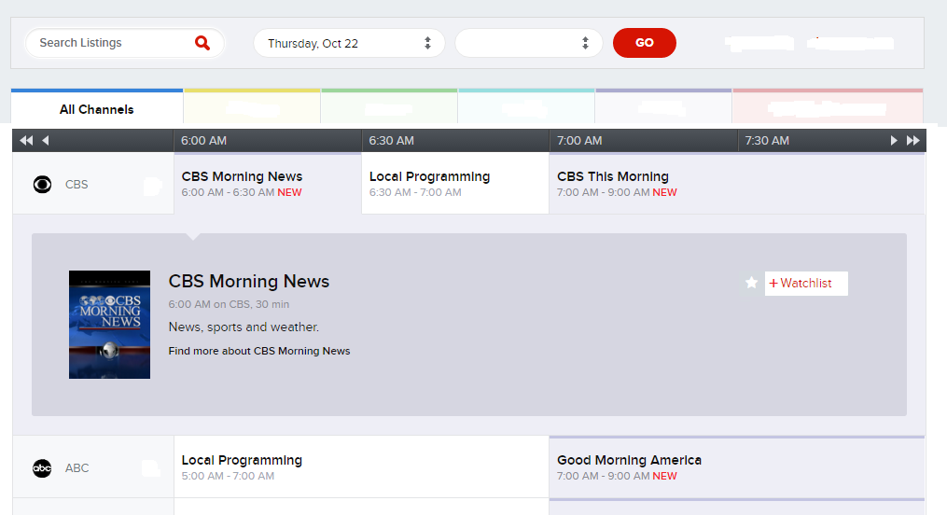

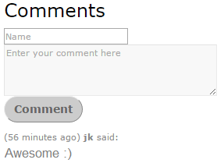


+
Category: News

Slide 45
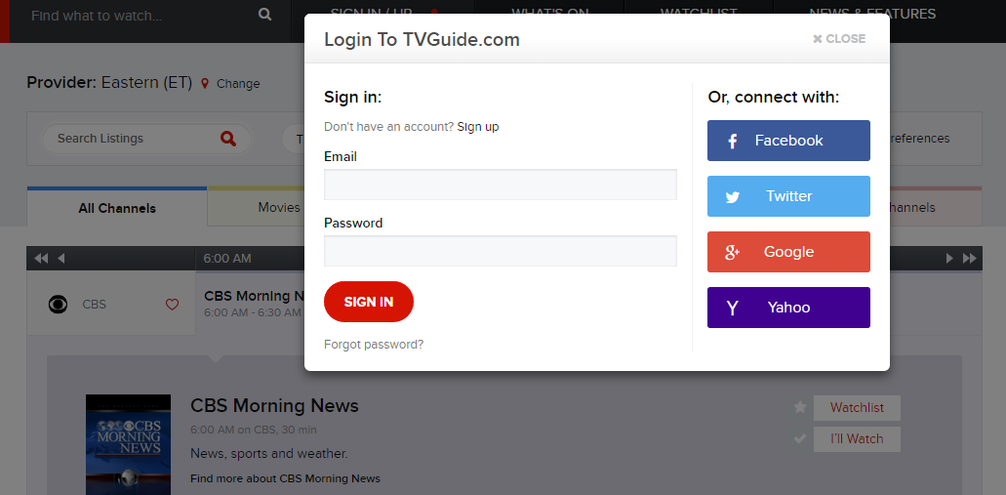
Leisure guide.com
Sign Up

Slide 46
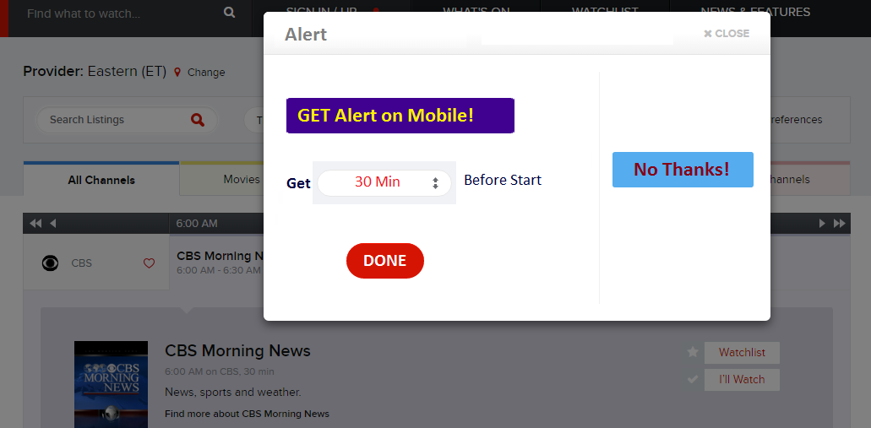
(free)

Slide 47

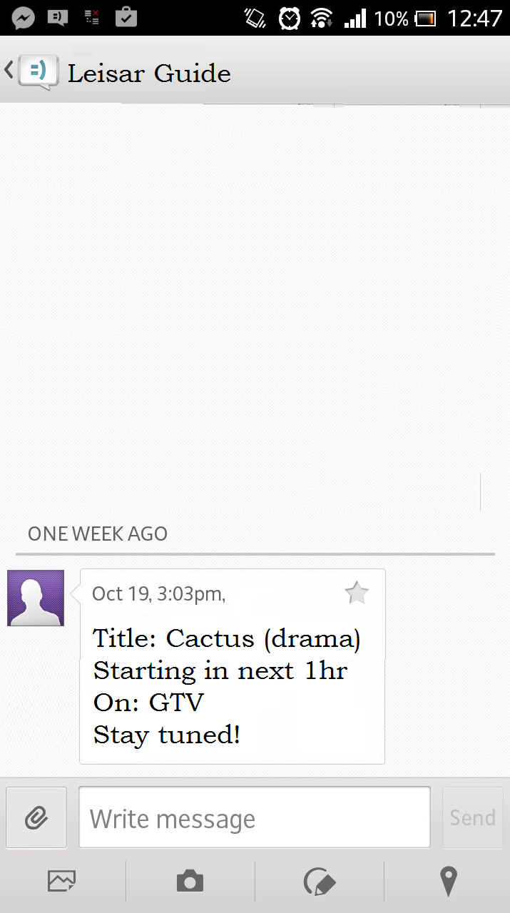

Slide 48
+
Category: News

Slide 49
Watch Live
Watch Live
Watch Live
Watch Live
Watch Live

Slide 50
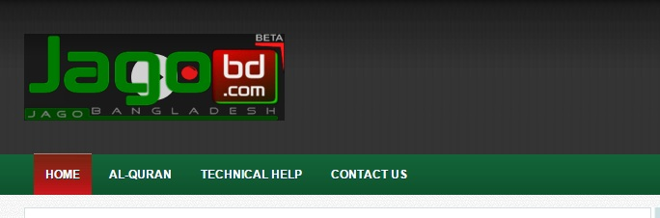
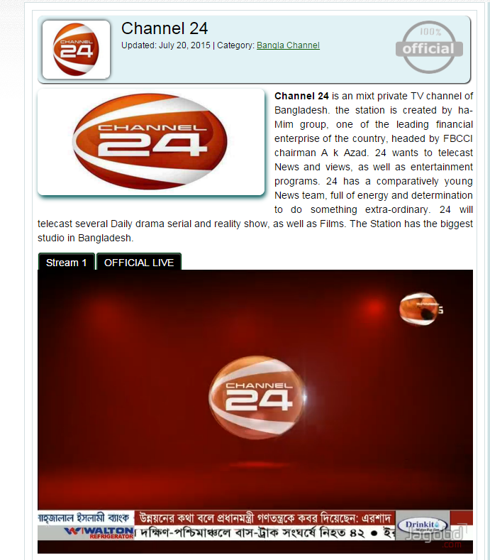
Live TV

Slide 51
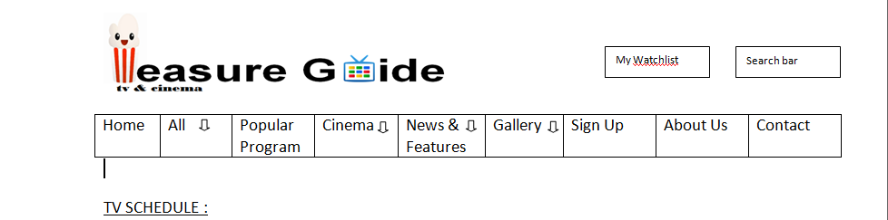

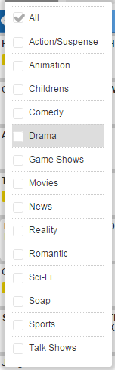
Telefilm
Watch Live
Watch Live
Watch Live
Watch Live
Watch Live

Slide 52

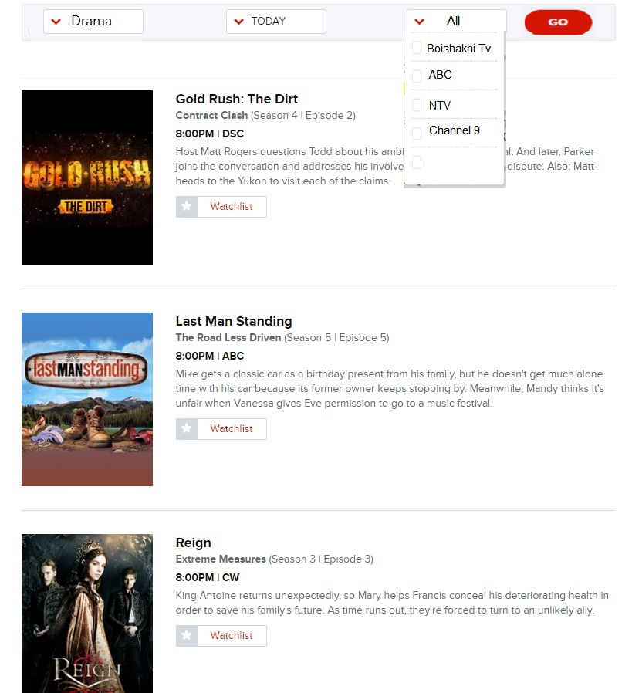
Categoriesed View

Slide 53

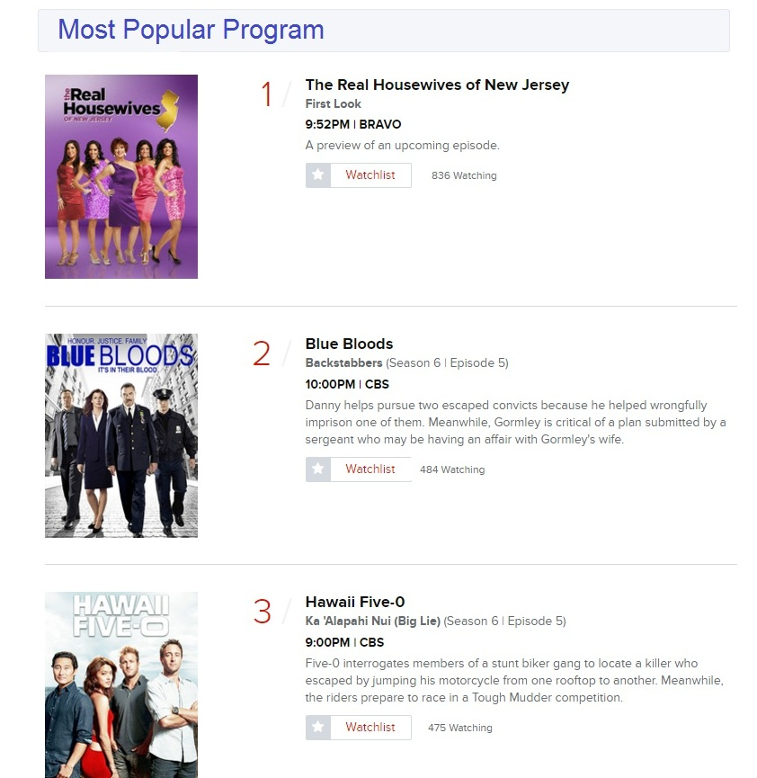

Slide 54
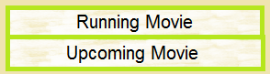
Watch Live
Watch Live
Watch Live
Watch Live
Watch Live

Slide 55
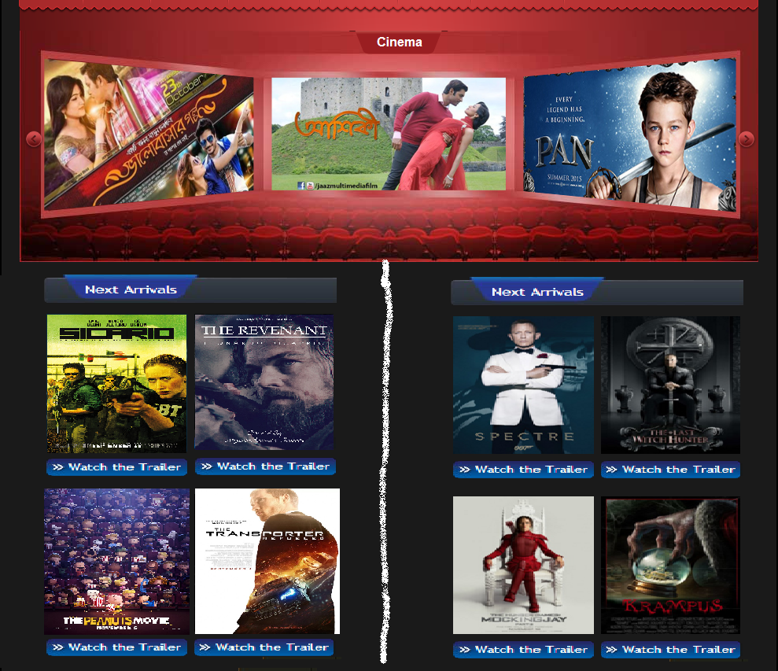

Slide 56
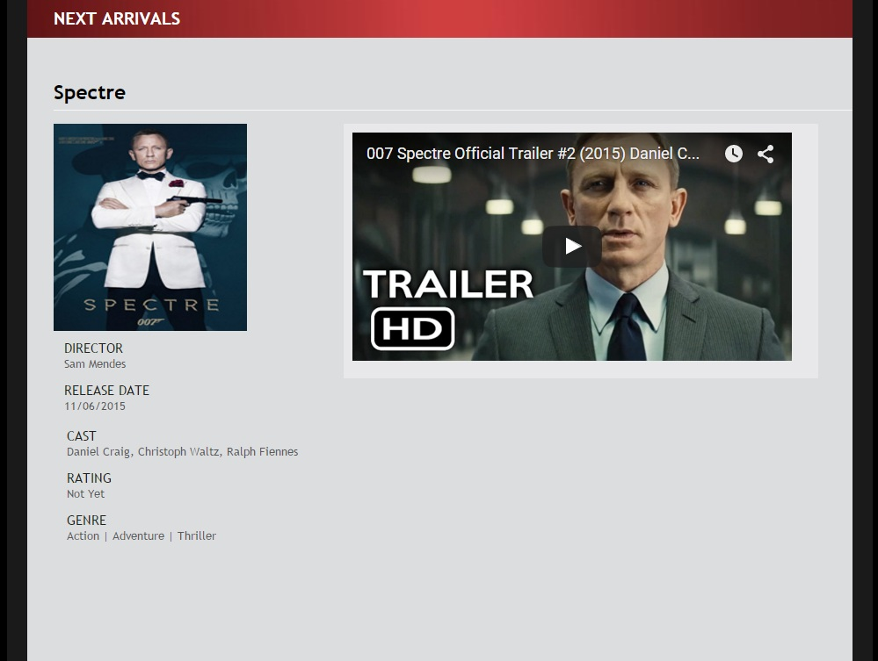
Hall List
IMDB
Star Cineplex
Book Ticket
Blockbuster Cinema
Book Ticket
-----

Slide 57
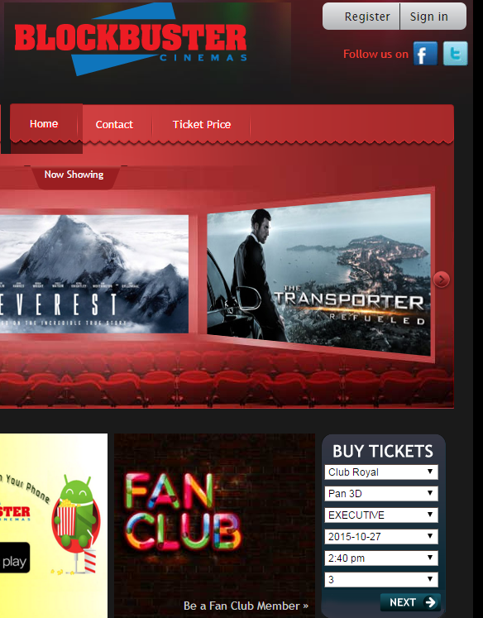
Hall List
Star Cineplex
Book Ticket
Blockbuster Cinema
Book Ticket
-----

Slide 58
Watch Live
Watch Live
Watch Live
Watch Live
Watch Live

Slide 59
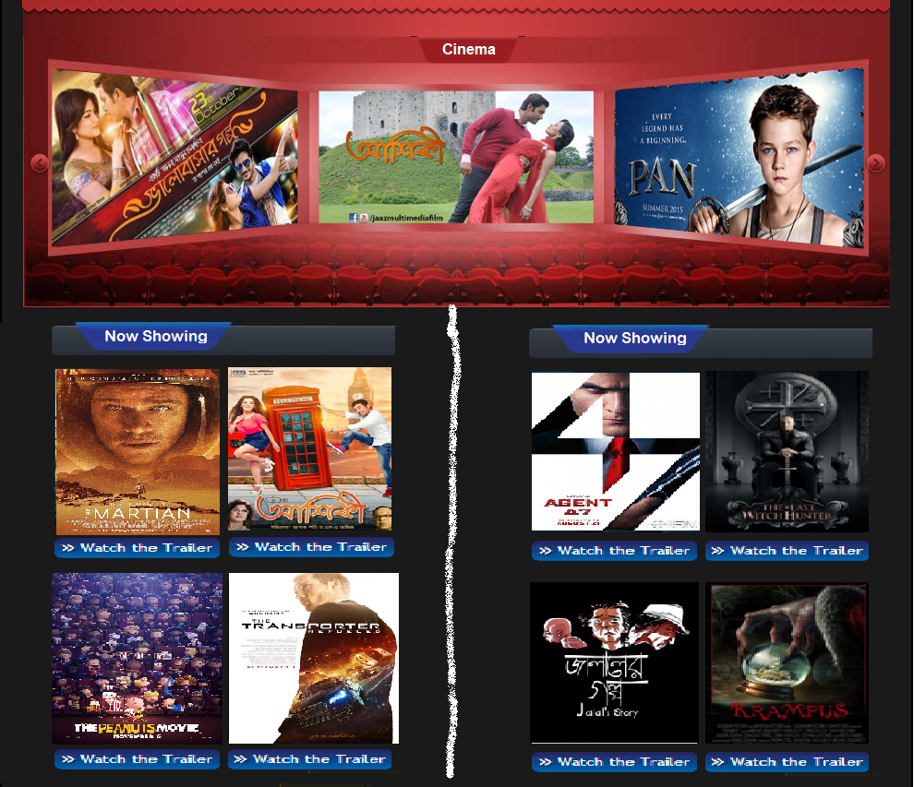

Slide 60
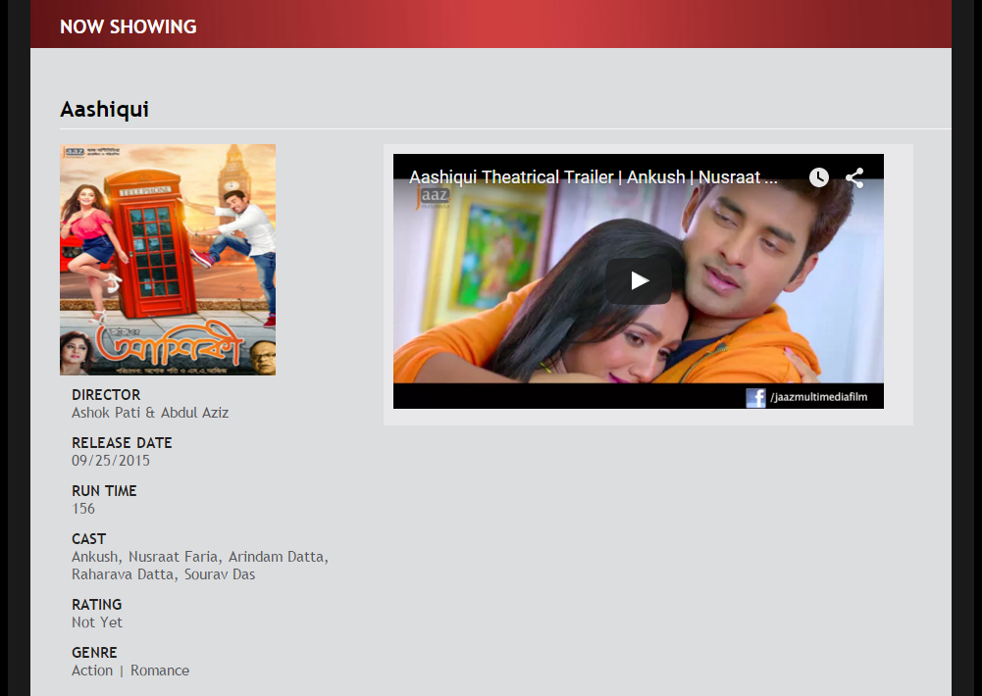
Hall List
Star Cineplex
Book Ticket
Blockbuster Cinema
Book Ticket
Shymoli Cinema
Book Ticket

Slide 61
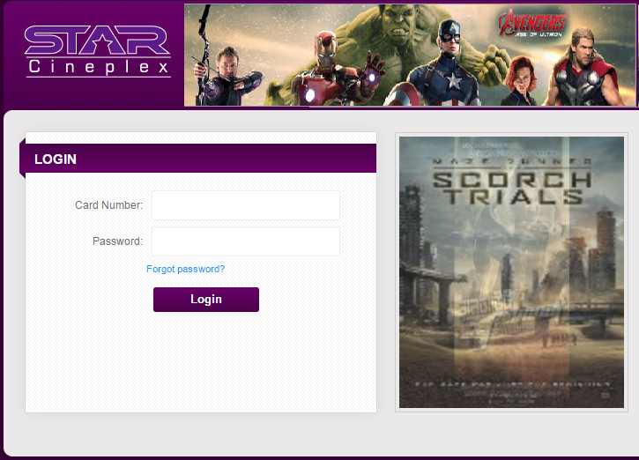
Hall List
Star Cineplex
Book Ticket
Blockbuster Cinema
Book Ticket
Shymoli Cinema
Book Ticket

Slide 62
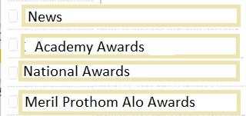
Watch Live
Watch Live
Watch Live
Watch Live
Watch Live

Slide 63
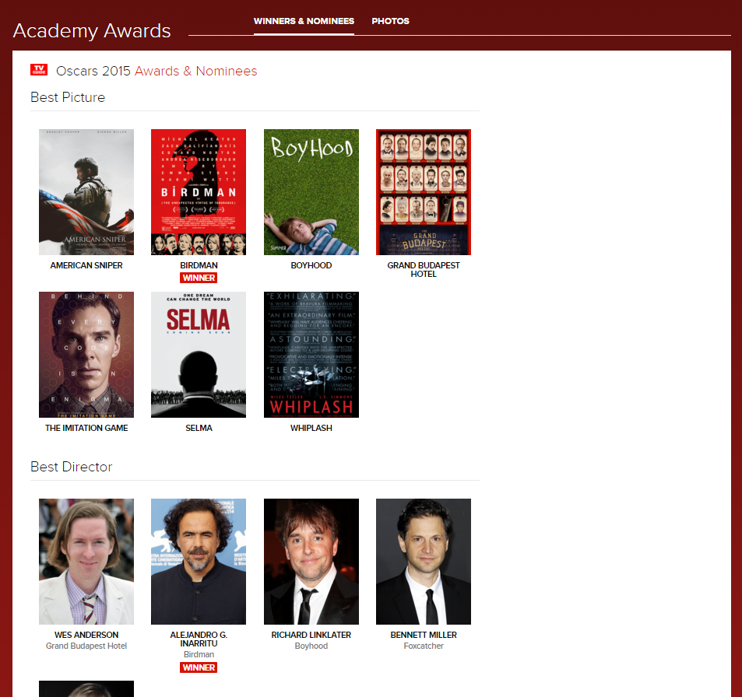

Slide 64
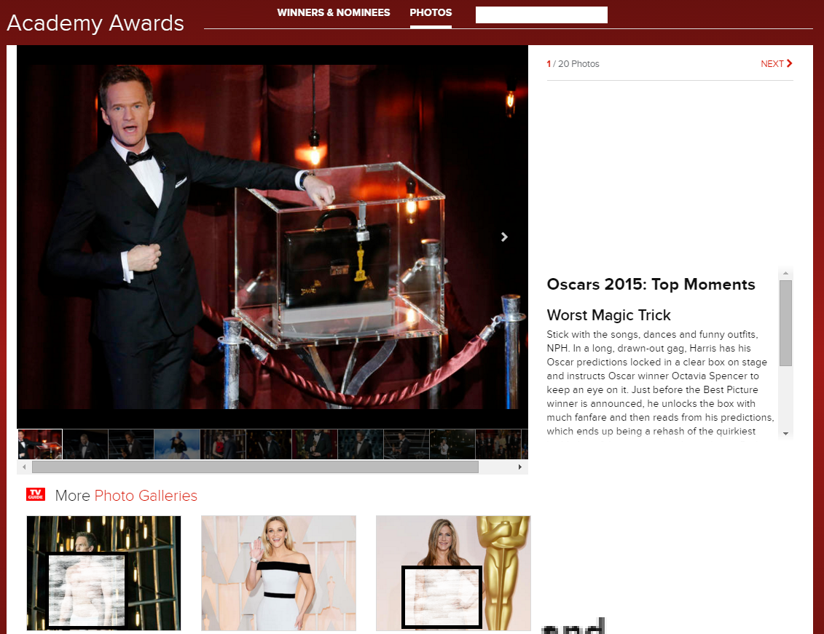


Slide 65
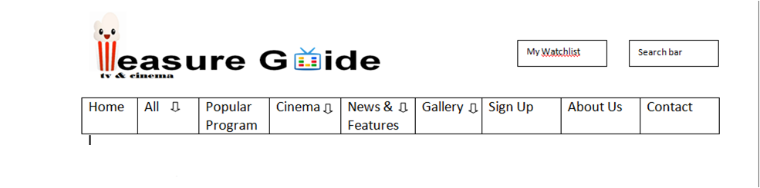
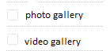
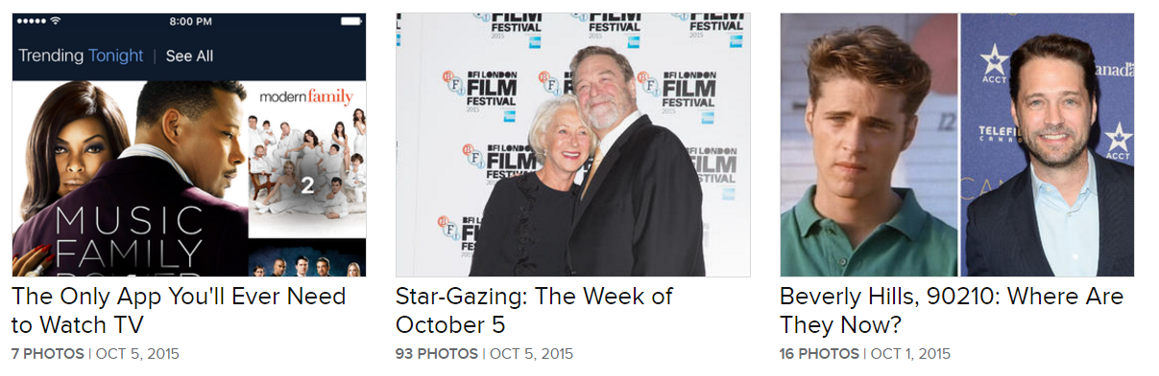
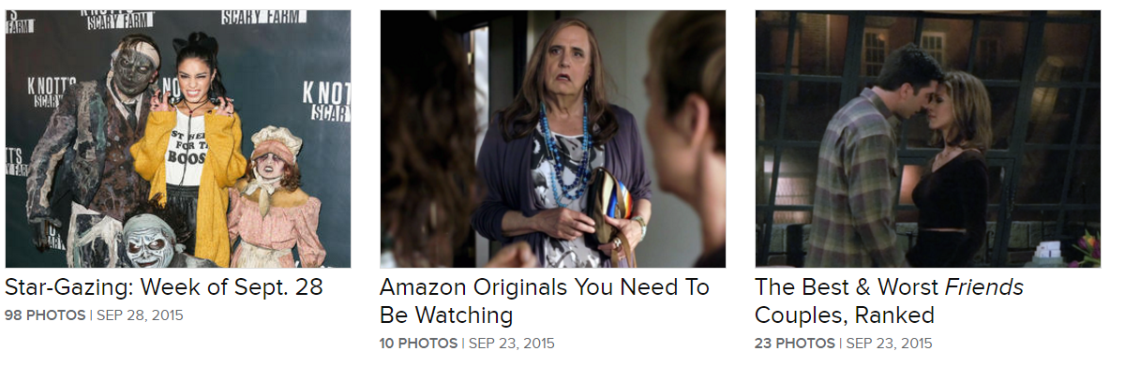

Slide 66
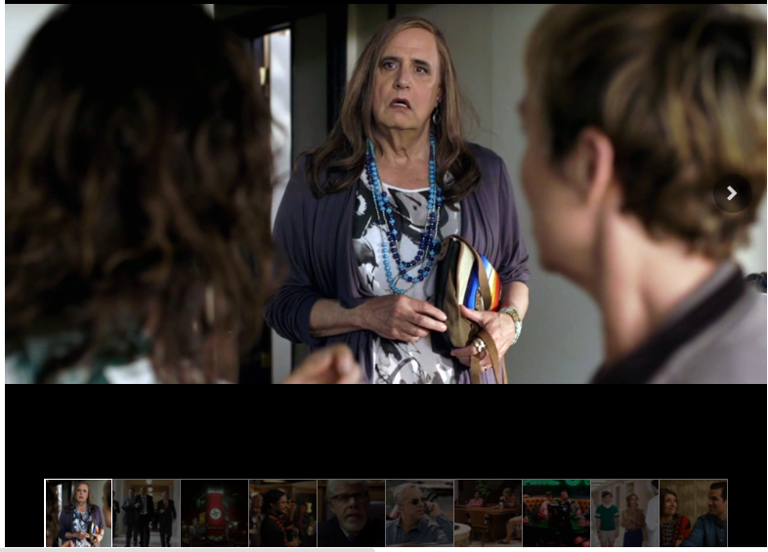

Slide 67
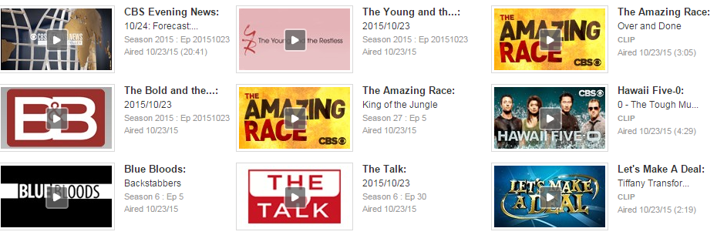

Slide 69


The amazing race: King of jungle

Slide 70
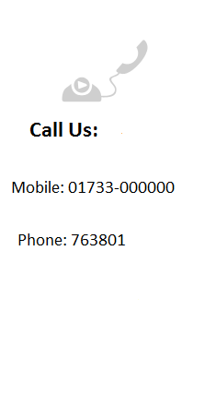



Slide 71
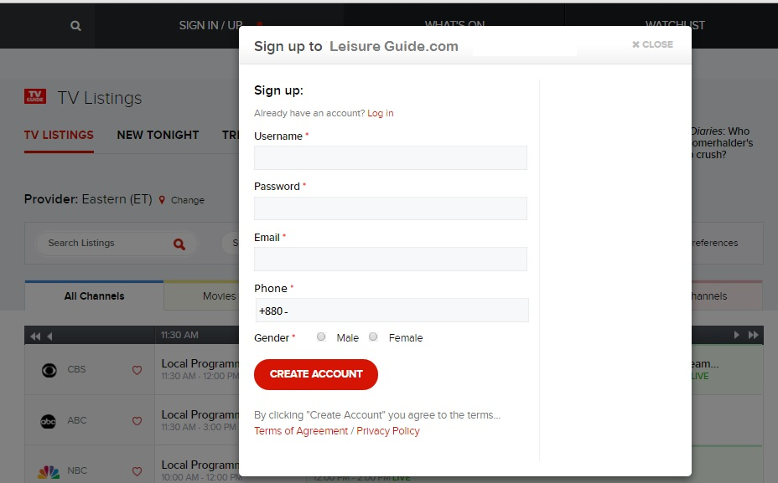


Slide 72

Leisure guide.com
Sign Up

Slide 73
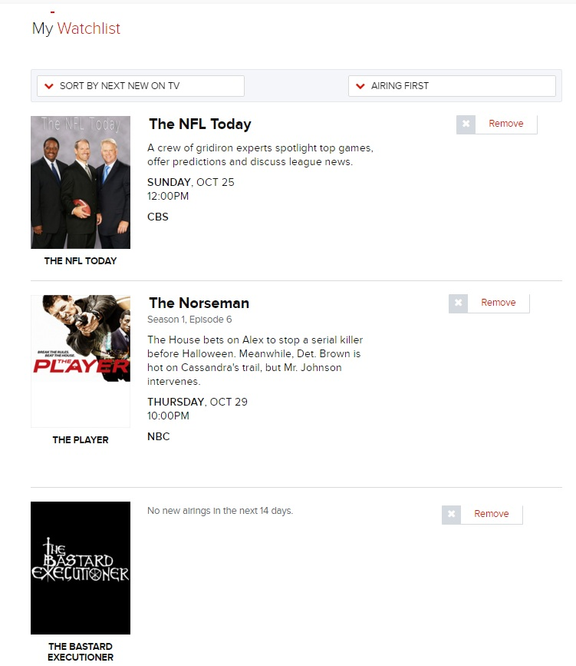
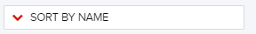

Slide 74
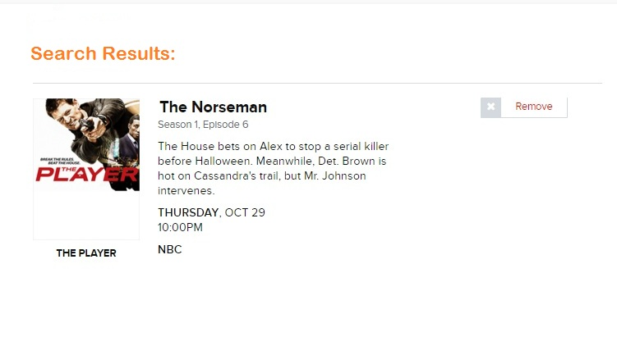
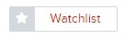
Norseman

Slide 75
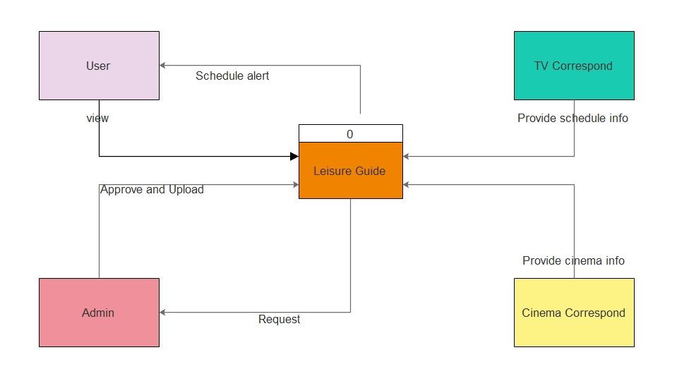
Context Diagram

Slide 77
Watch Live

Slide 78
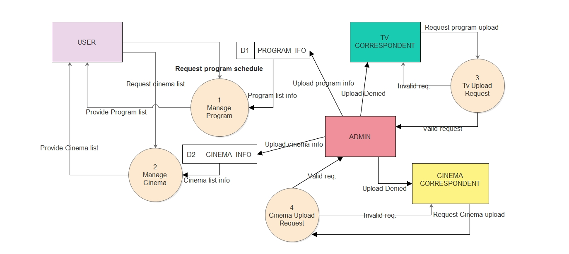
Level 0 DFD

Slide 80
Level 0 DFD

Slide 81
Level 0 DFD

Slide 82
+
Category: News

Slide 83
Leisure guide.com
Sign Up

Slide 84
(free)

Slide 86
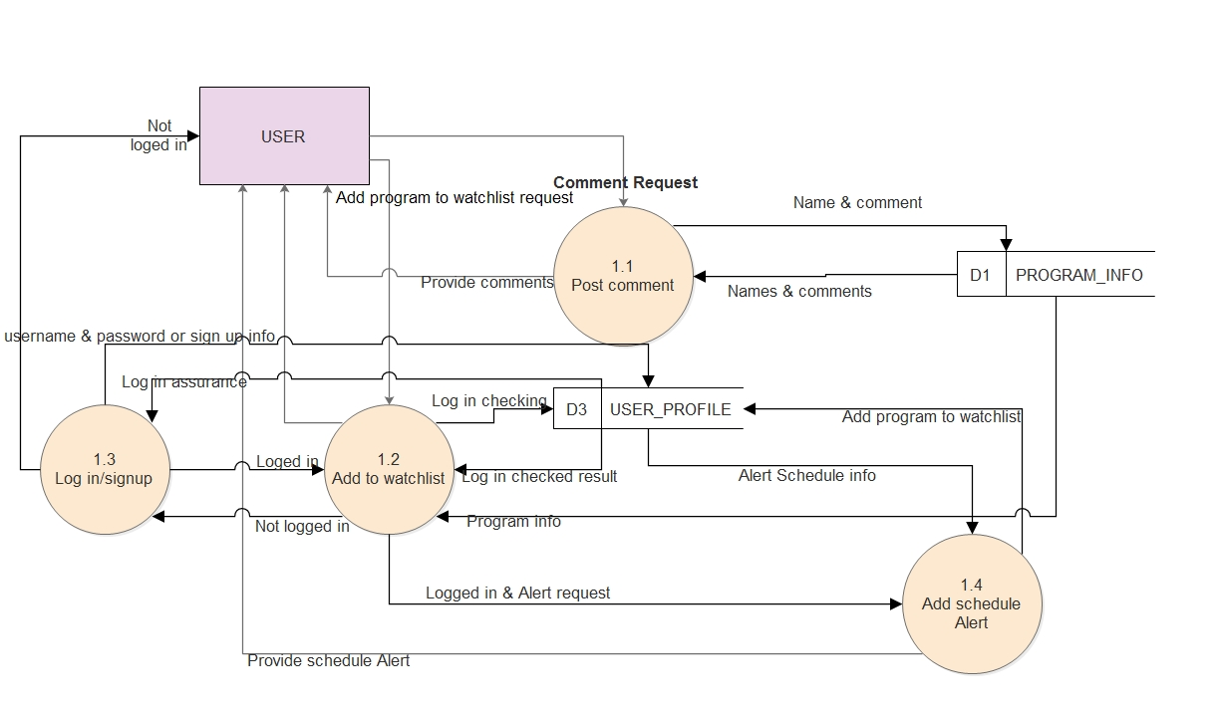
Level 1 DFD

Slide 87
+
Category: News

Slide 88
Level 1 DFD

Slide 89
Level 1 DFD

Slide 90
Watch Live

Slide 91
+
Category: News

Slide 92
Norseman

Slide 93
Leisure guide.com
Sign Up

Slide 94
(free)

Slide 96
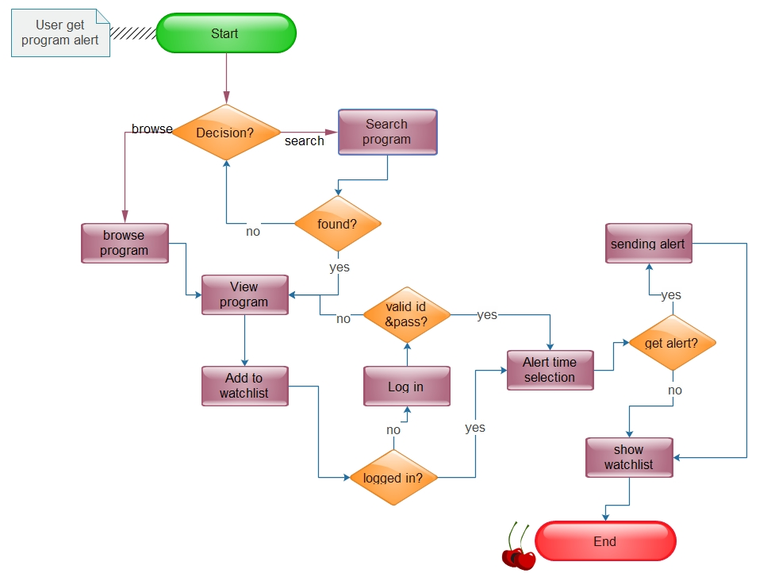
Activity diagram A

Slide 97
+
Category: News

Slide 98
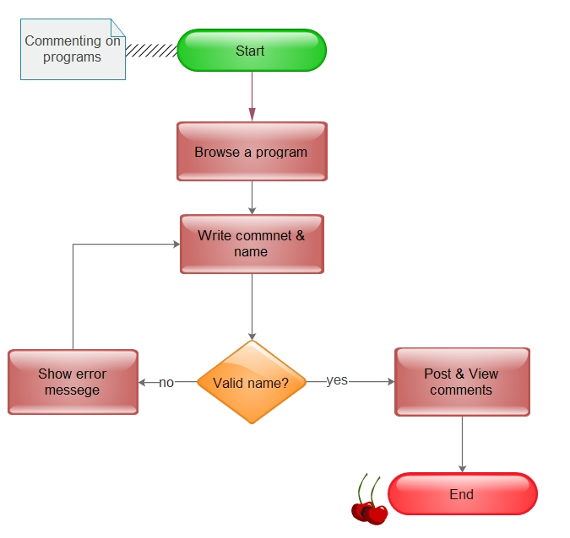
Activity diagram B

Slide 99
Watch Live
Watch Live
Watch Live
Watch Live
Watch Live

Slide 101
Hall List
IMDB
Star Cineplex
Book Ticket
Blockbuster Cinema
Book Ticket
-----

Slide 102
Hall List
Star Cineplex
Book Ticket
Blockbuster Cinema
Book Ticket
-----

Slide 103

Activity diagram C

Slide 104
Telefilm
Watch Live
Watch Live
Watch Live
Watch Live
Watch Live

Slide 105
Categoriesed View

Slide 106

Activity diagram D

Slide 107

Activity diagram E

Slide 108

USE CASE DIAGRAM
Leisure Guide
Manage Watchlist
TV correspondent
Cinema Service
User
Admin
Provide News & Event
Cinema
correspondent

Slide 109
Use Case 1: Manage Watchlist
Primary Actor: User
Steak holders and Interest:
-Admin: Accurate, fast entry and no error.
-TV Correspondent: Wants to provide TV program schedule with no error.

Slide 110
Use Case 1: Manage Watchlist
-User: Wants TV program listed schedule & add to watchlist for get alert.
Pre Conditions: User identified and authenticated.
Post Conditions: TV Schedule are saved.

Slide 111
Main success scenario of Manage Watchlist:
1. TV correspondent collect the program list with schedule from the TV channels respectively.
2. TV correspondent send request to admin for approval.
3. Admin approve it and TV correspondent upload it.
4. User see the program list and schedule for his/her preference.
5. He/she can comment about the program, but before that he/she has to be signed up or logged in.
6. He/she can add to his/her watchlist to get alert for that program. Time selection also be selected by the person.
7. User will notified on that particular time with program name and schedule.

Slide 112
Main success scenario of Cinema Service :
Cinema correspondent collect the cinema list of running cinema and upcoming cinema with schedule from the cinema hall respectively.
Cinema correspondent send request to admin for approval.
Admin approve it and cinema correspondent upload it.
User see the cinema list, schedule of running cinema and upcoming cinema on that hall for his/her preference.
User can book ticket for that particular Hall from cineplex’s ticket booking system.

Slide 113
Index
Class Diagram
CRC Cards
Sequence Diagram
State Diagram

Slide 114


Let’s Identify Different Classes From Use CASE DIAGRAM
Leisure Guide
Manage Watchlist
TV correspondent
Cinema Service
Admin
User
Provide News & Event
Cinema
correspondent

Slide 115



Class Diagram
signUp()
1
+
+
+
()
Composition

Slide 116

A CRC card for Class Watchlist

Slide 117

A CRC card for Class User

Slide 118

A CRC card for Class Admin
Programs.

Slide 119

A CRC card for Class TvCorrespondent

Slide 120

A CRC card for Class CinemaCorrespondent

Slide 121

A CRC card for Class Cinema Service

Slide 122

Sequence Diagram

Slide 123
State Diagram of Watchlist
Browse Program
search Program
Browsed Program
Searched Program
Show Program description
Show Program description
Program description shown
Request for add to watchlist and check login
Check login
Login Checked
Sign Up
Login
User registered
Logged in
Show Program description
Program added to watchlist
Set Alert
Alert has been set
End process
123

Slide 124
State Diagram of Commenting on a program
Browse Program
Program List shown
Write a comment and check name
Name checked
Write valid name and comment
Comment Written
Post the comment and view
Comment posted and viewed
End process

Slide 125
State Diagram of Cineplex Ticket Booking
Browse Cinema
search Cinema
Browsed Cinema
Searched cinema
Show cinema description
Show cinema description
Hall List
Select hall
Hall selected
Book ticket
Ticket booked
End process
125

Slide 126
Entity Relationship Diagram (ERD)
comment
User_Names
Comments
Name
BuyTicket_Link
*
Hall List
Has
Photo gallery images
*
Genere
Starting_Time
Rating
Has
Channel
1
Ending_time
Cast
1
Program_detail
Title
Program Information
Cinema Information
Title
Date
*
Category
Release_Date
Trailer_link
Get
1
Password
Watchlist
Make
User Profile
1
1
Alert _time
Phone
First Name
Last Name
Email

Slide 127
THANK YOU …..☺

